Slide 1
Segmentation Project Updates
Benjamin Green
06/18/2020

Slide 2
Discussion points
Changes to the UI
Some Result Images and User Status
Data Sharing

Slide 3
Discussion points
Changes to the UI
Some Result Images and User Status
Data Sharing

Slide 4
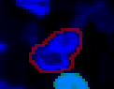
Review of outstanding issues
Cells could not be removed which is an issue for:
miss-segmented highly joint overlap pairs which are accepted by the comparison algorithm
Instances where both algorithms similarly performed wrong
or any other user mistakes

Slide 5

Current Solution
Implemented a cell removal button
(?should resemble a trash can?)
User clicks the button then clicks the cell to remove
Asked users to look over the final image review stage, delete the offending cells and add new ones

Slide 6
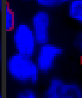
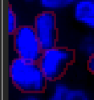
Review of outstanding issue 2
Cells can overlap either as a result of:
The applied segmentation
Or biology

Slide 7

Current Solution
Assign cells to separate ‘image planes’
Value moves the current cell to the numeric plane indicated, moving it in front of or behind other cells
If cells are in the same plane, cells reviewed later by the user appear on top
Since this order is independent of the user, the segmentation would always be recreated the same way

Slide 8

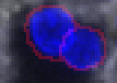
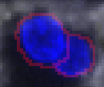
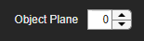
Current Solution
Assign cells to separate ‘image planes’
Value moves the specified cell to that plane in front or behind other cells
if cells are in the same plane, cells reviewed later by the user appear on top
Since this order is independent of the user, it recreates the segmentation the same every time

Slide 9
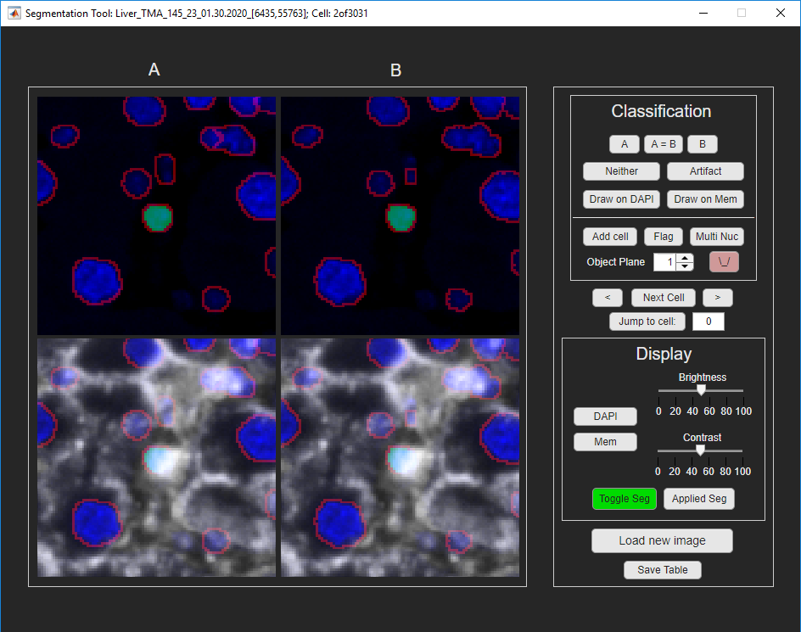
Current UI

Slide 10
Discussion points
Changes to the UI
Some Result Images and User Status
Data Sharing

Slide 11
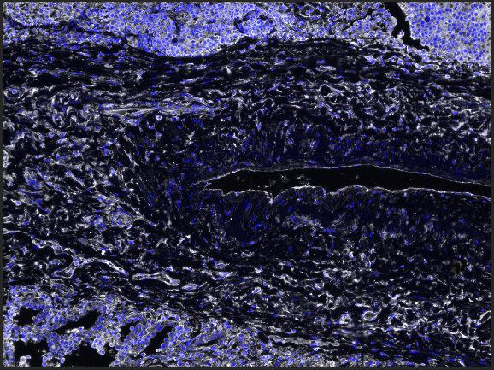
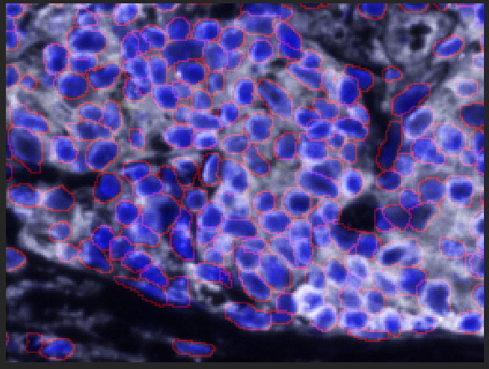
Lung_Adeno_TMA_1315_3_[5515,52497]
2,675 cells reviewed; 2,587 cells total

Slide 12
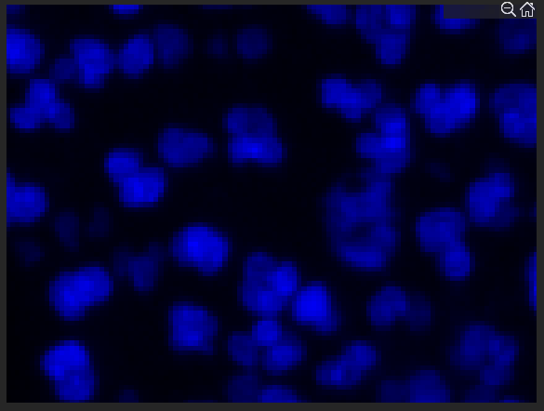
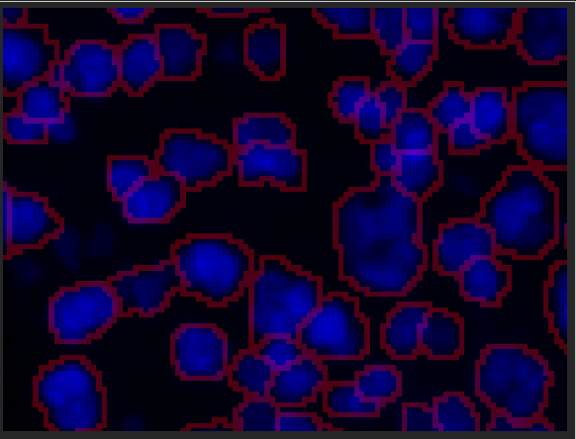
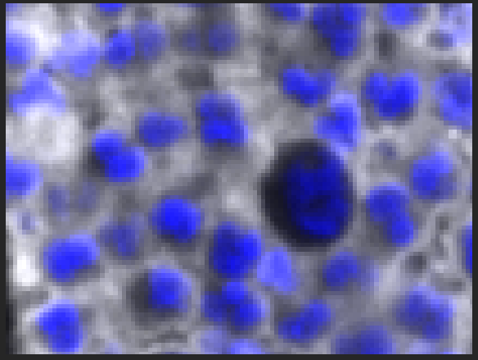
Lung_Adeno_TMA_1315_3_[5515,52497]
2,675 cells reviewed; 2,587 cells total

Slide 13
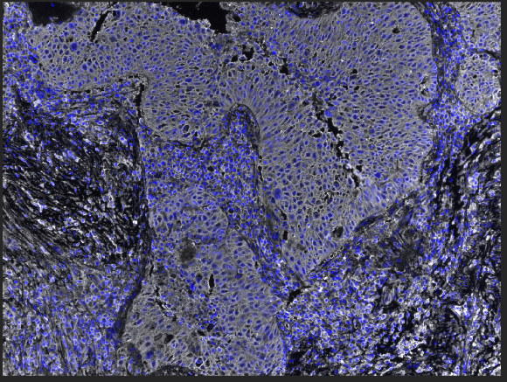
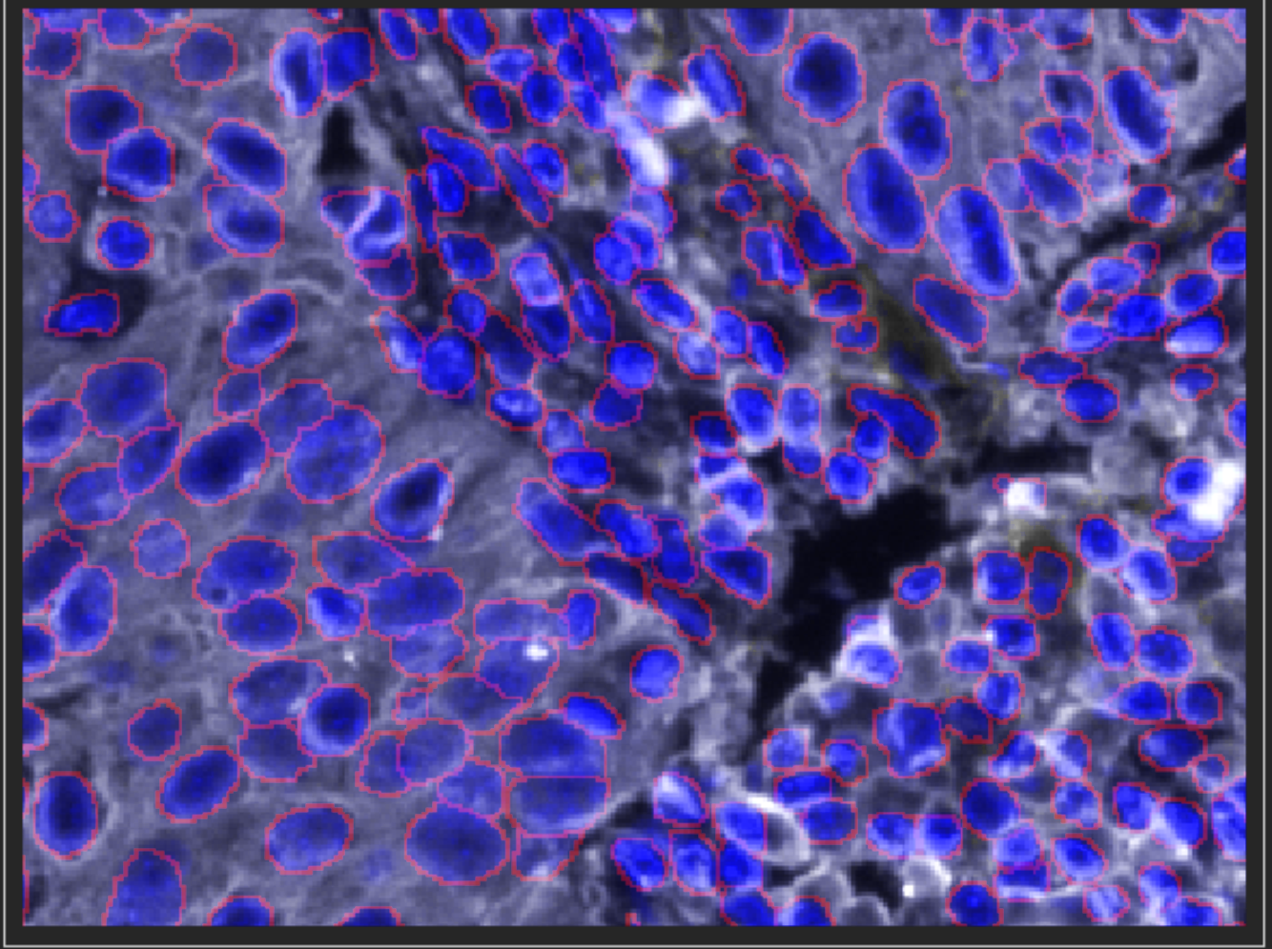
Lung_SCC_TMA_1314_6_01.30.2020
4,280 cells reviewed; 5,027 cells total

Slide 14
Images completed to date
Reviewer | # of Images Completed
1 | 6
2 | 5
3 | 1 Finished (overlap criteria failed for the rest of the images; needs to review cells)
4 | Working on 4 images. On whole image review for 3 images, Overlap criteria failed for one image
5 | Overlap criteria failed for all images; needs to review cells
6 | Overlap criteria failed for all images; needs to review cells

Slide 15
Data Sharing
Data for 11 images is ready to be shared
Sharing:
Label matrix
Csv file with two columns ‘cellid’ and ‘multinuc’ binary column indicating whether or not the cell has been indicated as a multi nucleated cell (1 for true)

Slide 16
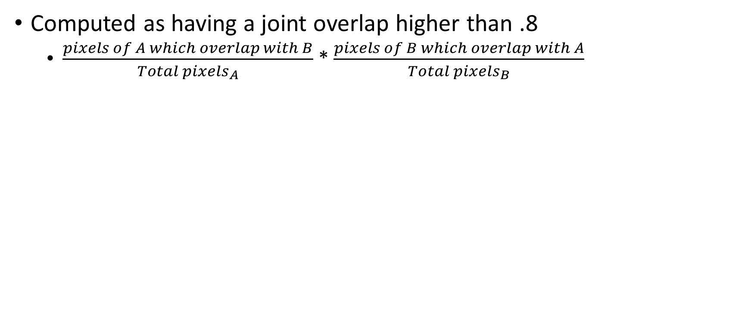
Comparison Algorithm
Computed as having a joint overlap higher than .8
$\frac{pixels of A which overlap with B}{{Total pixels}_{A}}$ * $\frac{pixels of B which overlap with A}{{Total pixels}_{B}}$
As the user reviews cells, track the disagreement of this JO review group; (defined as not ‘A=B’)
Compute number of pairs with joint overlap (JO) of greater than .8
Randomly choose 20% of these for review (call this the JO review group)
If at any point the user selects more than 20% of this JO review group as having disagreement.
Add the rest of the .8 overlap cells into the review set

Slide 17
Table format
IF_cellid | IF_X_centroid | IF_Y_centroid | SP_paired_w_IF | SP_cellid | SP_X_centroid | SP_Y_centroid | IF_paired_w_SP
cellid | IF_level | Joint_overlap | class_selection | cell_check | flags
Descriptions of ambiguous columns explained in next slides
I also save the drawn cell objects in a label matrix defined by the cellids shown here as the comparison_seg_data.tif

Slide 18
Ambiguous column descriptions:
SP_paired_w_IF and IF_paired_w_SP:
The cellid in the first type which corresponds to the current cellid of the second, serves as an additional coding check that the correct cells are paired. SP_paired_w_IF == SP_cellid and IF_paired_w_SP == IF_cellid.
IF_level:
The level or type of segmentation performed from inform
(1) immune segmentation
(2) tumor segmentation
Joint_overlap:
joint fractional overlap, from multiplying the fractional overlaps of each type

Slide 19
Ambiguous column descriptions cont.:
Class_selection:
Which type of segmentation to include
(0): not yet defined
(1): Inform type
(2): super pixel type
(3): drawn on
(4): joint overlap over .8 and set NOT to review
(5): reviewed as both
(6): added \ new cell
(-1): neither segmentation chosen and not drawn
(-2): artifact
Cell_check:
Whether or not that cell will be reviewed
(0): do not review (see (4) in class selection)
(1): review
(2): joint overlap over .8 and set to review

Slide 20
Ambiguous column descriptions cont. cont.:
Flags:
(1): Multi nucleated
(2): Flagged for review by user

